Slide 1
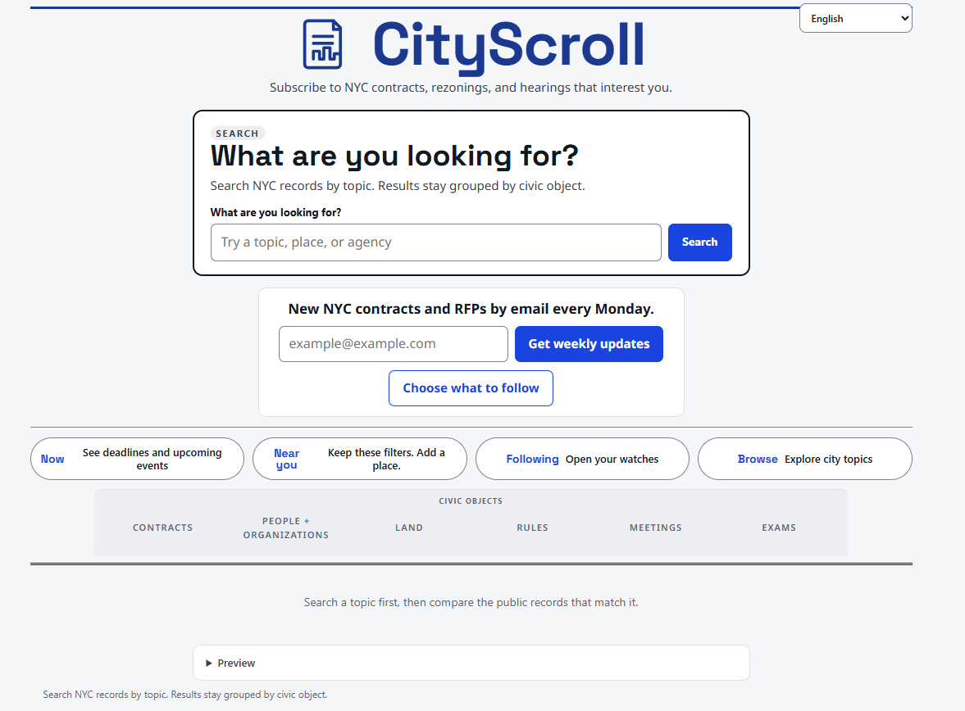
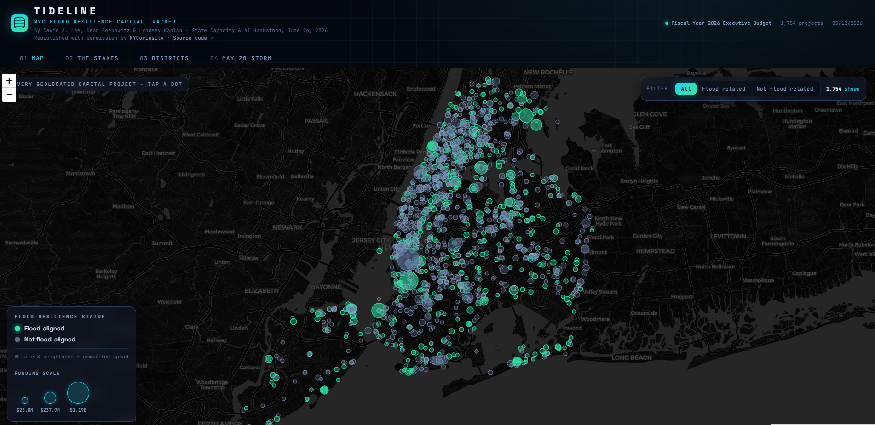
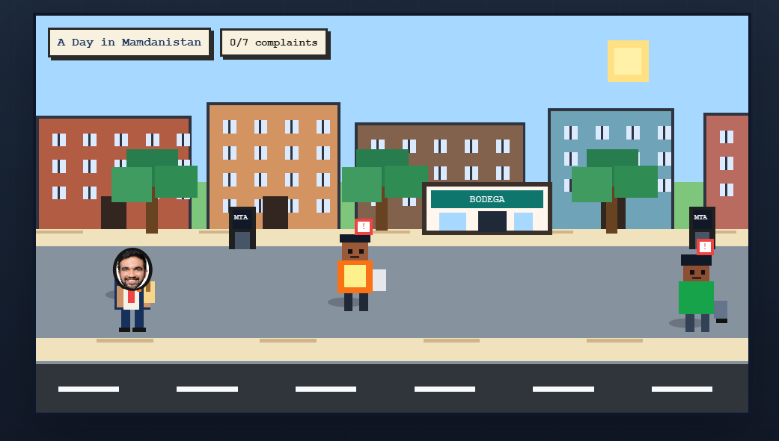
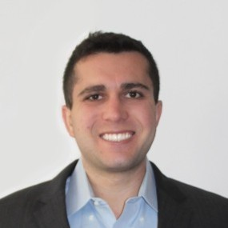



STATE CAPACITY ECOSYSTEM
The people helping government deliver find each other here.
Map the ecosystem. Put technologists and practitioners in the same room and turn what they build into something government can use. Expand the community. Repeat.
Vision A visible, connected ecosystem enabling a government with the talent, tools, and operating capacity to deliver for the people it serves.
WHAT WE DO
Ecosystem
Events
Community
We map who does what
We run the room
We keep people connected
Search, a Directory of 329 organizations, Connect for people and problems, and an Affinity Map. These databases help surface the problems and partners for the next event.
Hackathons are the flagship; demo nights and salons help fill the calendar. A government decision-maker is in every room. Every event ends with working tools and new relationships.
Slack and Substack between events, playbooks so anyone can run the format, and Proof Points for every tool built. The community adds itself to the map, and the loop turns again.
PROOF · STATE CAPACITY HACKATHON: A CIVIC TECH BUILD NIGHT
20+ tools built · 80+ builders · one night
City Scroll
Tideline
A Day in Mamdanistan
Real-time search across NYC contracts, rezonings, and hearings.
Maps 1,754 capital projects against citywide flood-resilience status.
A playable satire of everyday bureaucratic friction.
TEAM
Henry Grunzweig
Tal Roded
Jeremie Ponak
Sourabh Chakraborty
Vision and partnerships
Data and technology
Policy and programs
Tools and community
Interested in partnering or building with us?
statecapacityecosystem.com | statecapacityecosystem@gmail.com | statecapacityecosystem.substack.com

